Slide 1
Technical Assessment
Anele Mavi

Slide 2
Global Economic Overview
Global Macro Overview
Growth is slow but steady (~2.3%)
Inflation easing in most regions
Central banks shifting to rate cuts
Market sentiment cautiously optimistic
Geopolitical risk remains elevated

Slide 3
Global Economic Overview
Global Growth & Inflation Trends
US, India leading growth – China, Europe lagging
Inflation now close to target in DMs
Food & energy inflation still high in some Ems
Easing inflation supports fixed income

Slide 4
Global Economic Overview
Central Banks & Market Reaction
Fed and ECB signalling first rate cuts
Yields falling across developed markets
Bond prices stabilising
Risk appetite improving

Slide 5
Global Economic Overview
Geopolitics & Global Risk
Russia–Ukraine war continues
China–Taiwan tensions unresolved
Iran–Israel conflict raises oil shock risk
FX, energy, and capital flow risks elevated

Slide 6
Global Economic Overview
Global Macro Summary – Key Takeaways
Inflation is easing, rate cuts beginning
Growth steady but uneven
Markets are stabilising
Geopolitical uncertainty persists
Fixed income risk profile improving

Slide 7
SA Macro Overview
South Africa: Macro Snapshot
Weak but improving growth
Inflation easing, but still above target
SARB cautious on rates
Fiscal and FX risks remain

Slide 8
SA Macro Overview
SA Growth & Inflation
Growth ~1.2% for 2025
Load shedding easing, but impact lingers
CPI at ~5.5%, driven by food and services
SARB cautious, watching Fed/oil

Slide 9
SA Macro Overview
SARB Policy & Fiscal Pressure
Repo rate now at 7.25%
Debt/GDP remains above 74%
SOEs and debt service costs key concerns

Slide 10
SA Macro Overview
Local Marco Summary
Slow, fragile growth with easing inflation
SARB cautious, rates steady but potential cuts later
Fiscal pressure and high debt weigh on risk

Slide 11
Investment Perspective – Bond Market Impact
What do these macro factors mean for a fixed income portfolio?
Credit Risk: In a low growth environment, the risk of corporate defaults increases.
Interest Rate Risk: The "higher-for-longer" global narrative and local inflation create uncertainty about the direction of SARB policy and bond yields.
Liquidity Risk: Political and economic uncertainty can cause market liquidity to dry up, making it hard to trade corporate bonds without a significant price impact.
Sovereign Risk: The election outcome directly impacted the perceived risk of holding South African government debt.

Slide 12
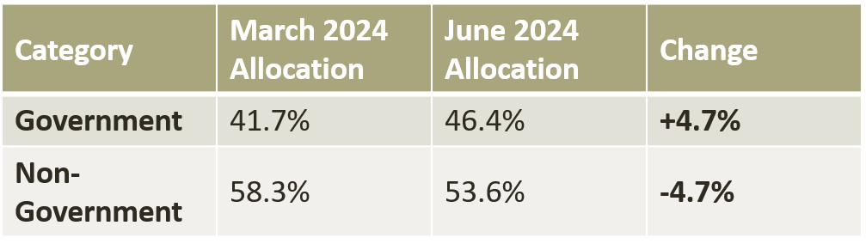
Portfolio Analysis
A Defensive Shift to Government Bonds
Finding: The portfolio's primary strategic move was a significant rotation out of corporate credit and into sovereign debt.

Slide 13
Portfolio Analysis
Largest Overweight Position: NINETY ONE CORPORATE BOND-Z fund (+22.3%).
Largest Underweight Positions: Long dated government bonds (e.g., R2048, R2035, R2037).
Finding: The strategy was not a simple purchase of all government bonds. It was to take strong negative bets on long duration bonds and outsourced corporate exposure to a specialist fund.

Slide 14
Portfolio Analysis
Top Buys: The five largest increases in active weight were all in South African Government Bonds.
Top Sells: The most significant reduction was in cash, followed by trimming various other bond positions.
Finding: The defensive rotation was an active and deliberate process, funded by deploying cash reserves.

Slide 15
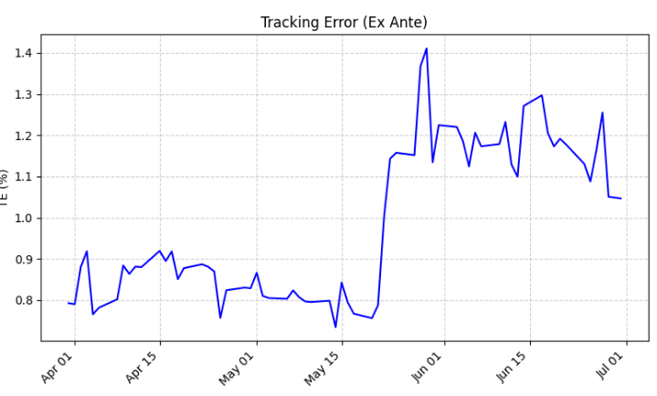
Historical Evolution
Active Risk Increased Despite Defensive Shift
Tracking Error rose from 0.79% to 1.05% during Q2.

Slide 16
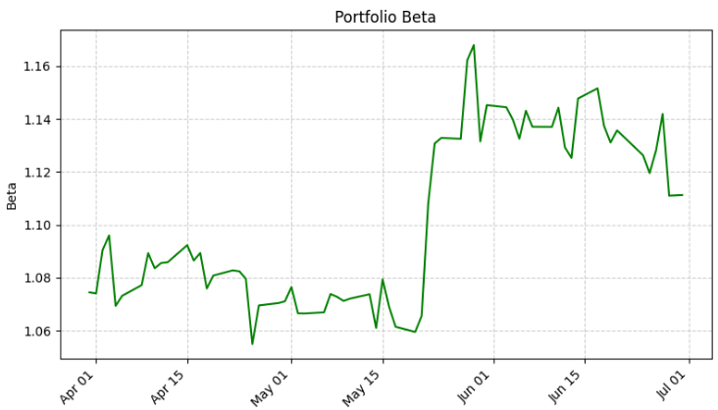
Historical Evolution
Market Sensitivity Remained Stable
The portfolio's Beta remained stable and slightly above 1, moving from 1.07 to 1.11.

Slide 17
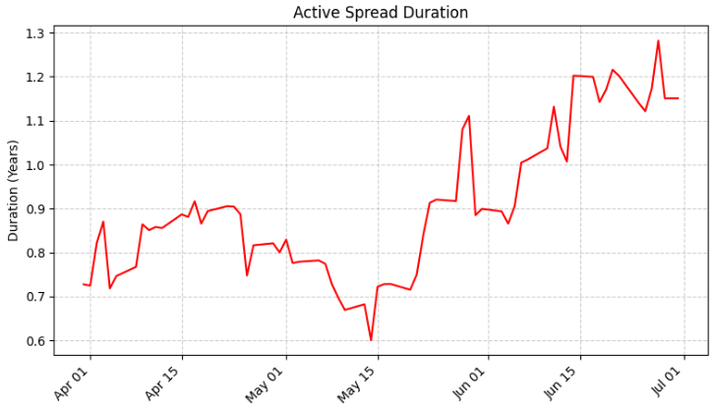
Historical Evolution
Sensitivity to Credit Spreads Increased
Active Spread Duration, the sensitivity to changes in credit spreads, increased from 0.73 to 1.15.

Slide 18
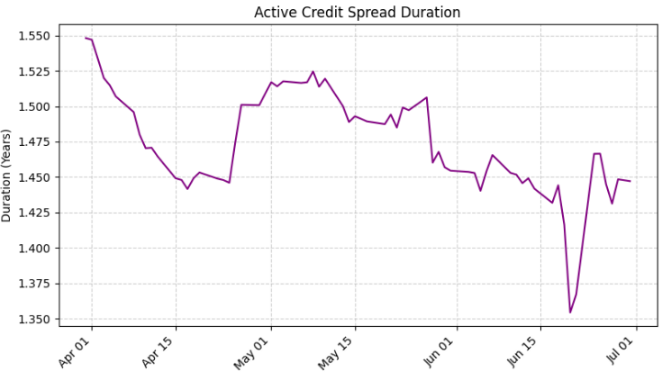
Historical Evolution
Credit Duration Remained Relatively Stable
The active credit spread duration remained relatively stable, moving from 1.55 to 1.45.

Slide 19
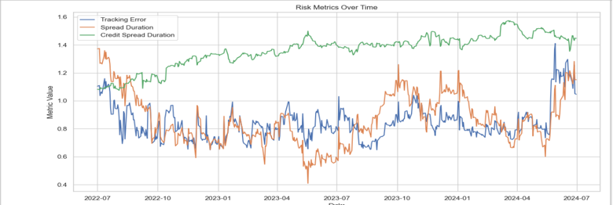
Historical Evolution
Tracking Error, Spread Duration, and Credit Spread Duration (2022–2024)
This chart shows the evolution of key portfolio risk metrics over the past two years.

Slide 20
Historical Evolution
Tracking Error has increased steadily, reflecting more active positioning. Rose from ~0.8 to ~1.2 .
Spread Duration rose sharply in 2024, driven by the overweight in the Corporate Bond-Z fund.
Credit Spread Duration remained relatively stable (1.2 -1.5), indicating controlled credit exposure.

Slide 21
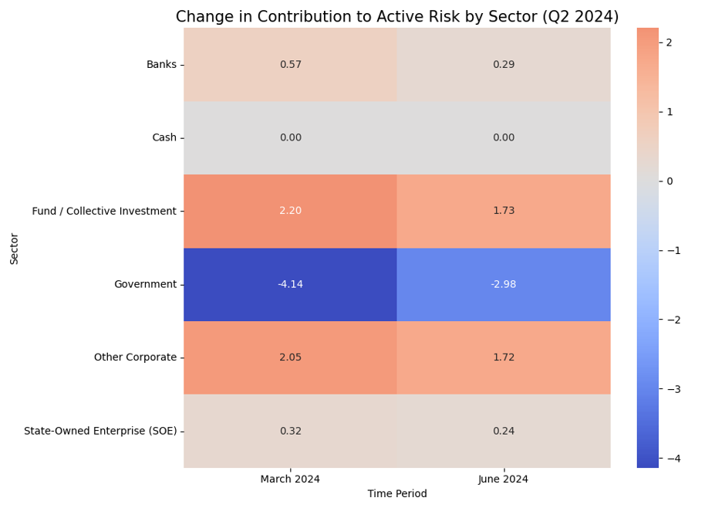
Visualizing Risk Contribution by Sector (Q2 2024)
The heatmap below shows how each sector contributed to active risk in March and June 2024.

Slide 22
Visualizing Risk Contribution by Sector (Q2 2024)
Government Bonds remained the largest contributor to active risk, though their contribution declined slightly.
Fund/Collective Investment saw a sharp drop in risk contribution, reflecting reduced exposure or reallocation.
Banks and Other Corporates also contributed less to risk, consistent with the portfolio’s de-risking strategy
SOEs remained stable, indicating high-conviction positions were maintained.

Slide 23
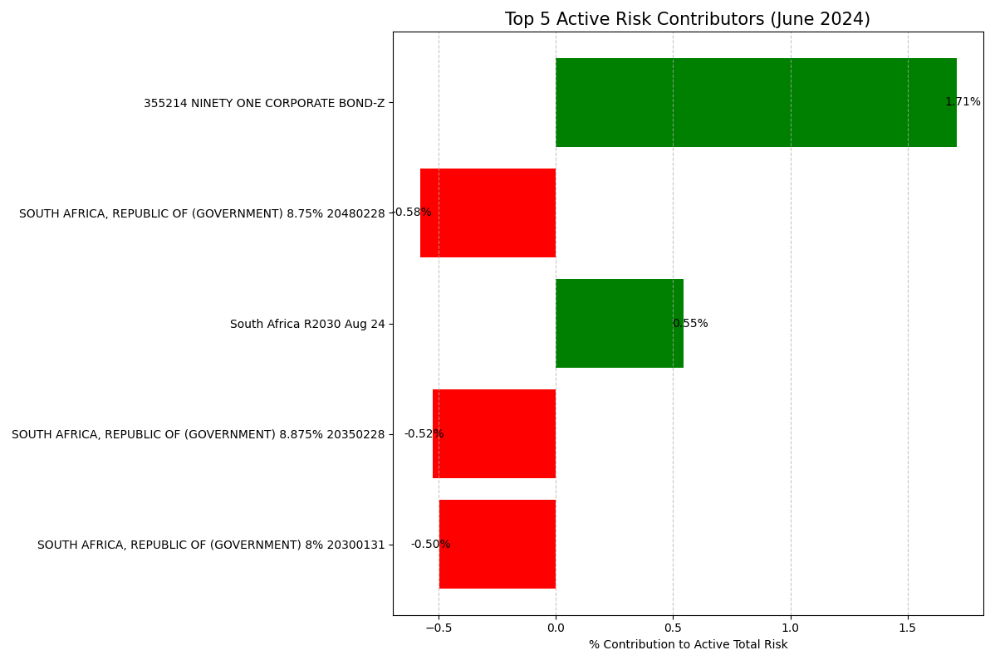
Top 5 Active Risk Contributors – June 2024
Instrument-Level Risk Attribution
The chart below highlights the five instruments with the highest contribution to active total risk as of June 2024.

Slide 24
Top 5 Active Risk Contributors – June 2024
Instrument-Level Risk Attribution
NINETY ONE CORPORATE BOND-Z is the largest contributor, reflecting the portfolio’s high-conviction overweight in this fund.
Several long-dated government bonds also appear, with negative contributions, indicating their underweight status and sensitivity to interest rate shifts.
This mix of positive and negative contributors reflects a deliberate balance between credit and duration risk.

Slide 25
Key Highlight - A Highly Tactical Shift
Deployed Cash into Government Bonds: The most significant move was deploying cash reserves (-4.6% of portfolio weight) almost directly into Government bonds (+4.7%).
Targeted De-risking, Not Wholesale Selling: Exposure to individual Bank bonds was reduced, which are sensitive to the economic cycle.
Maintained High-Conviction Positions: Exposure to State Owned Enterprises (SOEs) and the external corporate bond fund remained stable.

Slide 26
Impact on the Portfolio's Risk Profile
Improved Credit Quality & Liquidity: The shift to sovereign debt from corporate debt enhanced the portfolio's credit profile and its ability to transact in a stressed market.
Increased Active Risk (Tracking Error): Despite the defensive asset shift, the fund's Tracking Error increased, as large, high-conviction bets against specific long-term bonds were taken.
Concentrated Risk Driver (Proxy for VaR): The portfolio's risk is now less driven by individual corporate performance and more by one single factor: the direction of South African long-term interest rates.

Slide 27
Conclusion
The Situation: The second quarter was challenging. There was a lot of uncertainty around the world and important political changes in South Africa. At the same time, economic growth remained weak, both globally and in South Africa.
The Action: To manage risk, the portfolio moved into a more cautious position. It reduced exposure to corporate bonds and added more government bonds, using available cash to make the shift.
The Nuance: This was not just a move to play it safe. The team stayed active - they chose not to buy longer-term government bonds, which can be more sensitive to future interest rate changes. Credit exposure was managed more selectively. This helped balance risk and liquidity.
Overall: The decision reflects what’s happening in the bigger picture: inflation is coming down, interest rates are starting to fall, and South Africa’s debt levels are still a concern. The portfolio is positioned to benefit from falling rates while avoiding areas that might be too risky right now.

